Slide 1
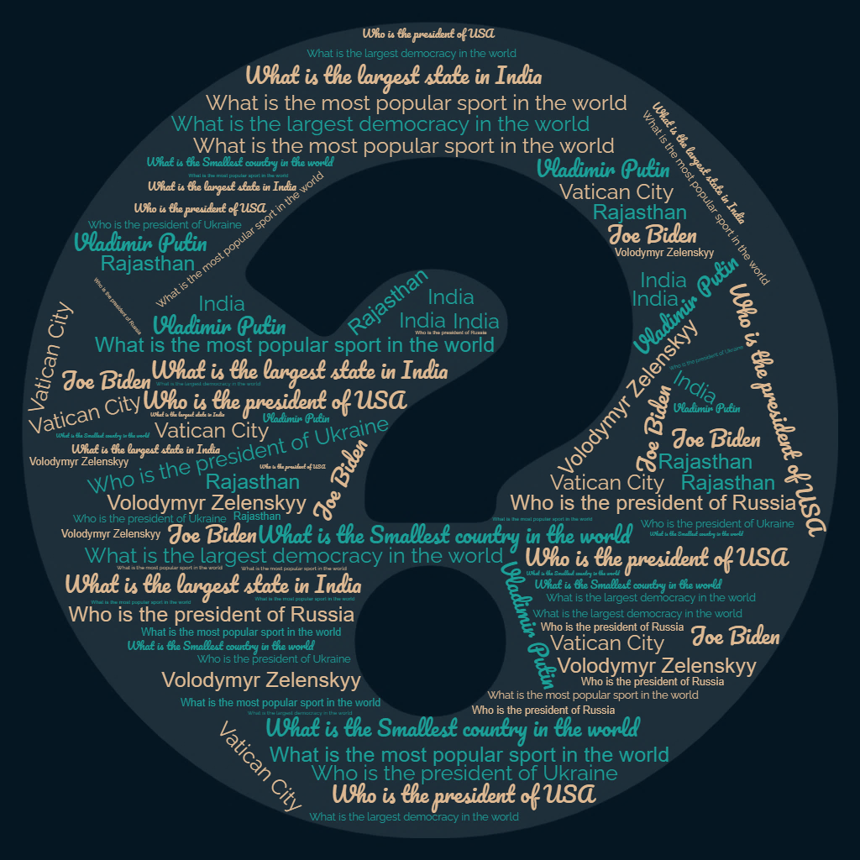
Distractors for MCQ using NLP and Transfer Learning
ROJI AUGUSTINE
rojiaugustine@gmail.com

Slide 2
Distractors for MCQ using NLP and Transfer Learning
A multiple-choice question (MCQ) is composed of two parts: a stem that identifies the question or problem, and a set of alternatives or possible answers that contain a key that is the best answer to the question, and a number of distractors that are plausible but incorrect answers to the question. The problem statement is to generate Distractors (wrong choices) for MCQ .

Slide 3
Solution Description
Solution is created using NLP tools – Transformers, sense2vec, wordnet, conceptne and porterstemmer.
Considered multiple tools to get the distractors and applied ensemble techniques to get the final distractor list. NLP tools sense2vec, wordnet, conceptne provide distractors based only on the answer . So to include the relevance of question , used Transformer based pertained classifier on the question and selected the distractors with highest probability
Ensembling approach is used to pick more relevant distractors . As mentioned above, One approach is to run a classifier on the question and choose the distractors with highest probability from the distractor list. Second approach is to pick the distractors which are occurred maximum. During testing it is found that the distractors based on maximum occurrence gave best performance.
The user is also able to mention number of distractors required (NO_OF_DISTRACTORS)
, which is typically 3 or 4.
Also used Porter stemmer to handle the tenses / forms of words. Eg, If ‘ball’ is the answer, then ‘balls’ should not be present in the distractor list

Slide 4
Solution Description contd..
Tools sense2vec, wordnet, conceptnet are having their on weaknesses. So the ensembling approach helps to get best set of distractors.
Some of the weaknesses noticed while development of this solution are
sense2vec is working with most of the cases like Country name, sports Animals etc.
wordnet will not work for Geographical info like Country name etc. But it is working for Sports, Animals etc
conceptnet works for Geographical details like Country name, Sports, but not good for Animal names
Also the solution creates 3 sets of distractors as below
Few samples from consolidated list of distractors
Most frequent distractors from all the above NLP tools
Distractors based on classifier probability

Slide 5
Development tools/SDKs/APIs
Python
Jupyter notebook for development
wordnet, sense2vec, wordnet, conceptne, transformer, porterstemmer

Slide 6
Sample Data
'What is the largest democracy in the world' : 'India',
'Which species can live in water as well as on land' : 'Frog',
'What is the largest state in India' : 'Rajasthan',
'What is the most popular sport in the world' : 'Soccer',
'What is the tallest animal in the world' : 'Giraffes',
'What is the sum of 1 and 3' : '4',
'Which position is Jupiter at' : 'Fifth',
'In the equation 10 devided by 1000, what is the remainder' : '10',
'Who discovered electricity' : 'Benjamin Franklin',
'Who invented Telephone' : 'Alexander Graham Bell',
'Who discovered America' : 'Christopher Columbus',
'What is the Smallest country in the world' : 'Vatican City',
'What is the National bird of India' : 'Peacock',
'Who is the president of Russia' : 'Vladimir Putin',
'Who is the president of USA' : 'Joe Biden'

Slide 7
Code, Test cases and Test results
Jupyter notebook is attached with zip file in the submission
For Sample output, please click on the attachment given below

Slide 8
References
https://towardsdatascience.com
https://www.nltk.org/howto/wordnet.html
https://conceptnet.io/
https://github.com/explosion/sense2vec

Slide 9
Thank You

